Slide 1
Jamie has 80 beads in blue and green in a ratio $5 :3$
They are then given additional beads. They are given the same number of both colours and now have a ratio $13 :9$
How many beads were they given?
$$\begin{matrix}B :G & \text{Total} \\ 5 :3 & 8 \\ 50 :30 & 80\end{matrix}$$
$$\begin{matrix}\text{B}\text{efore} & & & \text{After} & \\ B :G & \text{Diff} & & B :G & \text{Diff} \\ 50 :30 & 20 & & 13 :9 & 4 \\ & & & & \\ & & & & 20\end{matrix}$$
$$×10$$
$$×5$$

Slide 2
Jamie has blue to green beads in a ratio $5 :2$
They exchange some blue beads for the same number of green beads.
The ratio of beads is now $4 :5$
What is the smallest number of beads they could have started with?
How many beads did they exchange?
$$\begin{matrix}\text{B}\text{efore} & & & \text{After} & \\ B :G & \text{Total} & & B :G & \text{Total} \\ 5 :2 & 7 & & 4 :5 & 9 \\ & & & & \end{matrix}$$

Slide 3
Jamie has 90 beads in blue and green in the ratio $3 :7$
They gave away the same number of each bead.
Now they have beads in the ratio $1 :7$
How many beads do they have at the end?
$$\begin{matrix}B :G & \text{Total} \\ 3 :7 & \\ : & 90\end{matrix}$$
$$\begin{matrix}\text{B}\text{efore} & & & \text{After} & \\ B :G & \text{Diff} & & B :G & \text{Diff} \\ & & & 1 :7 & 6 \\ & & & & \end{matrix}$$

Slide 4
Jamie and Tyler have beads in a ratio of $4 :5$
Jamie gives some of their beads to Tyler.
The ratio is now $3 :7$
Find the smallest number of beads they could have started with and how many beads Jamie gives to Tyler.

Slide 5
The following ratios are equivalent
$x−1 :x+1$ and $x+3 :x+7$
Find $x$
$$\begin{matrix} & \text{Diff} \\ x−1 :x+1 & 2 \\ & \\ x+3 :x+7 & 4\end{matrix}$$
$$2\left(x−1\right)=x+3$$
$$×2$$

Slide 6
The following ratios are equivalent
$14−x :4+x$ and $20−3x :1+3x$
Find $x$
$$\begin{matrix} & \text{Total} \\ 14−x :4+x & 18 \\ & \\ 20−3x :1+3x & 21\end{matrix}$$

Slide 7
The following ratios are equivalent
$14+x :19+x$ and $24+3x :30+3x$
Find $x$

Slide 8
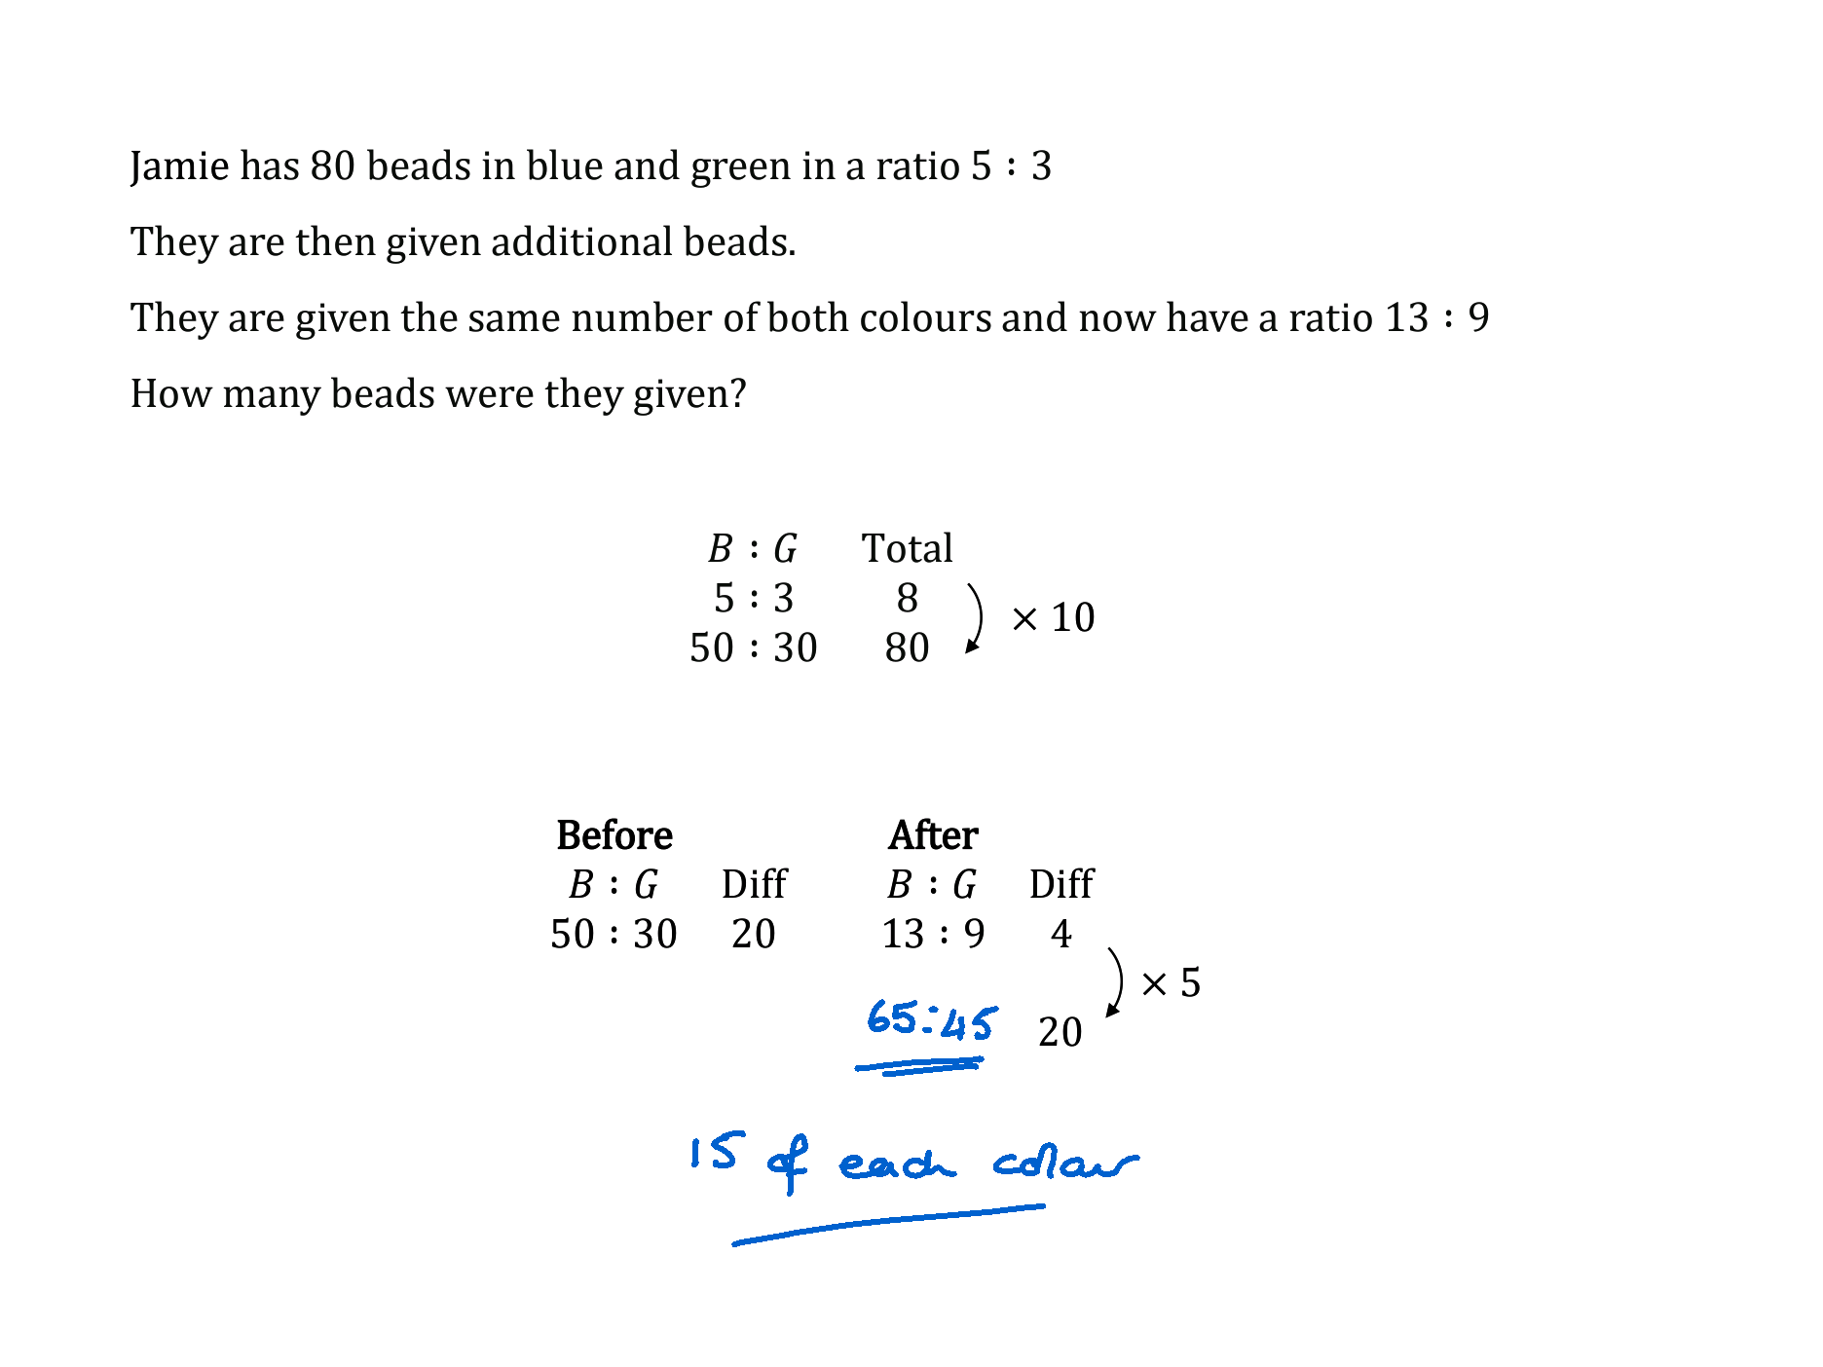
Jamie has 80 beads in blue and green in a ratio $5 :3$
They are then given additional beads. They are given the same number of both colours and now have a ratio $13 :9$
How many beads were they given?
$$\begin{matrix}B :G & \text{Total} \\ 5 :3 & 8 \\ 50 :30 & 80\end{matrix}$$
$$\begin{matrix}\text{B}\text{efore} & & & \text{After} & \\ B :G & \text{Diff} & & B :G & \text{Diff} \\ 50 :30 & 20 & & 13 :9 & 4 \\ & & & & \\ & & & & 20\end{matrix}$$
$$×10$$
$$×5$$

Slide 9
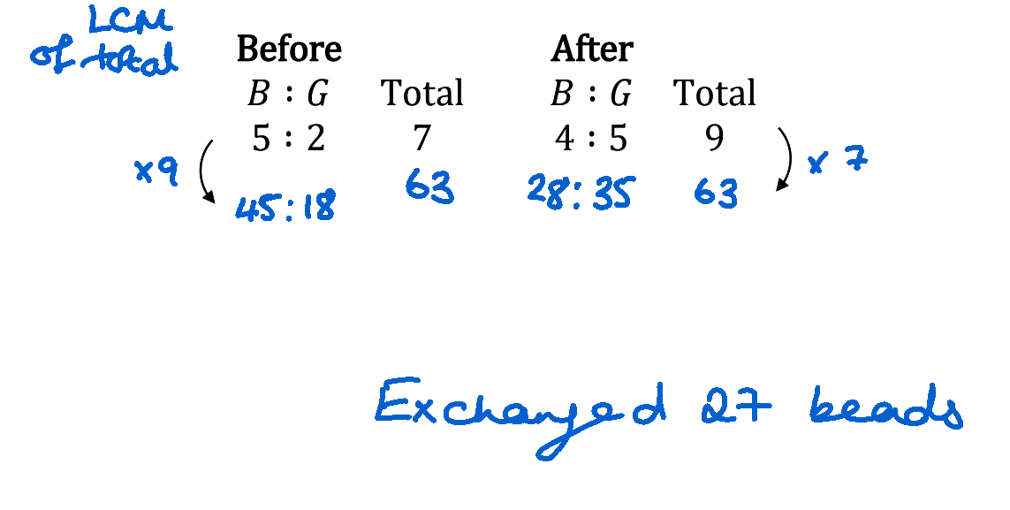
Jamie has blue to green beads in a ratio $5 :2$
They exchange some blue beads for the same number of green beads.
The ratio of beads is now $4 :5$
What is the smallest number of beads they could have started with?
How many beads did they exchange?
$$\begin{matrix}\text{B}\text{efore} & & & \text{After} & \\ B :G & \text{Total} & & B :G & \text{Total} \\ 5 :2 & 7 & & 4 :5 & 9 \\ & & & & \end{matrix}$$

Slide 10
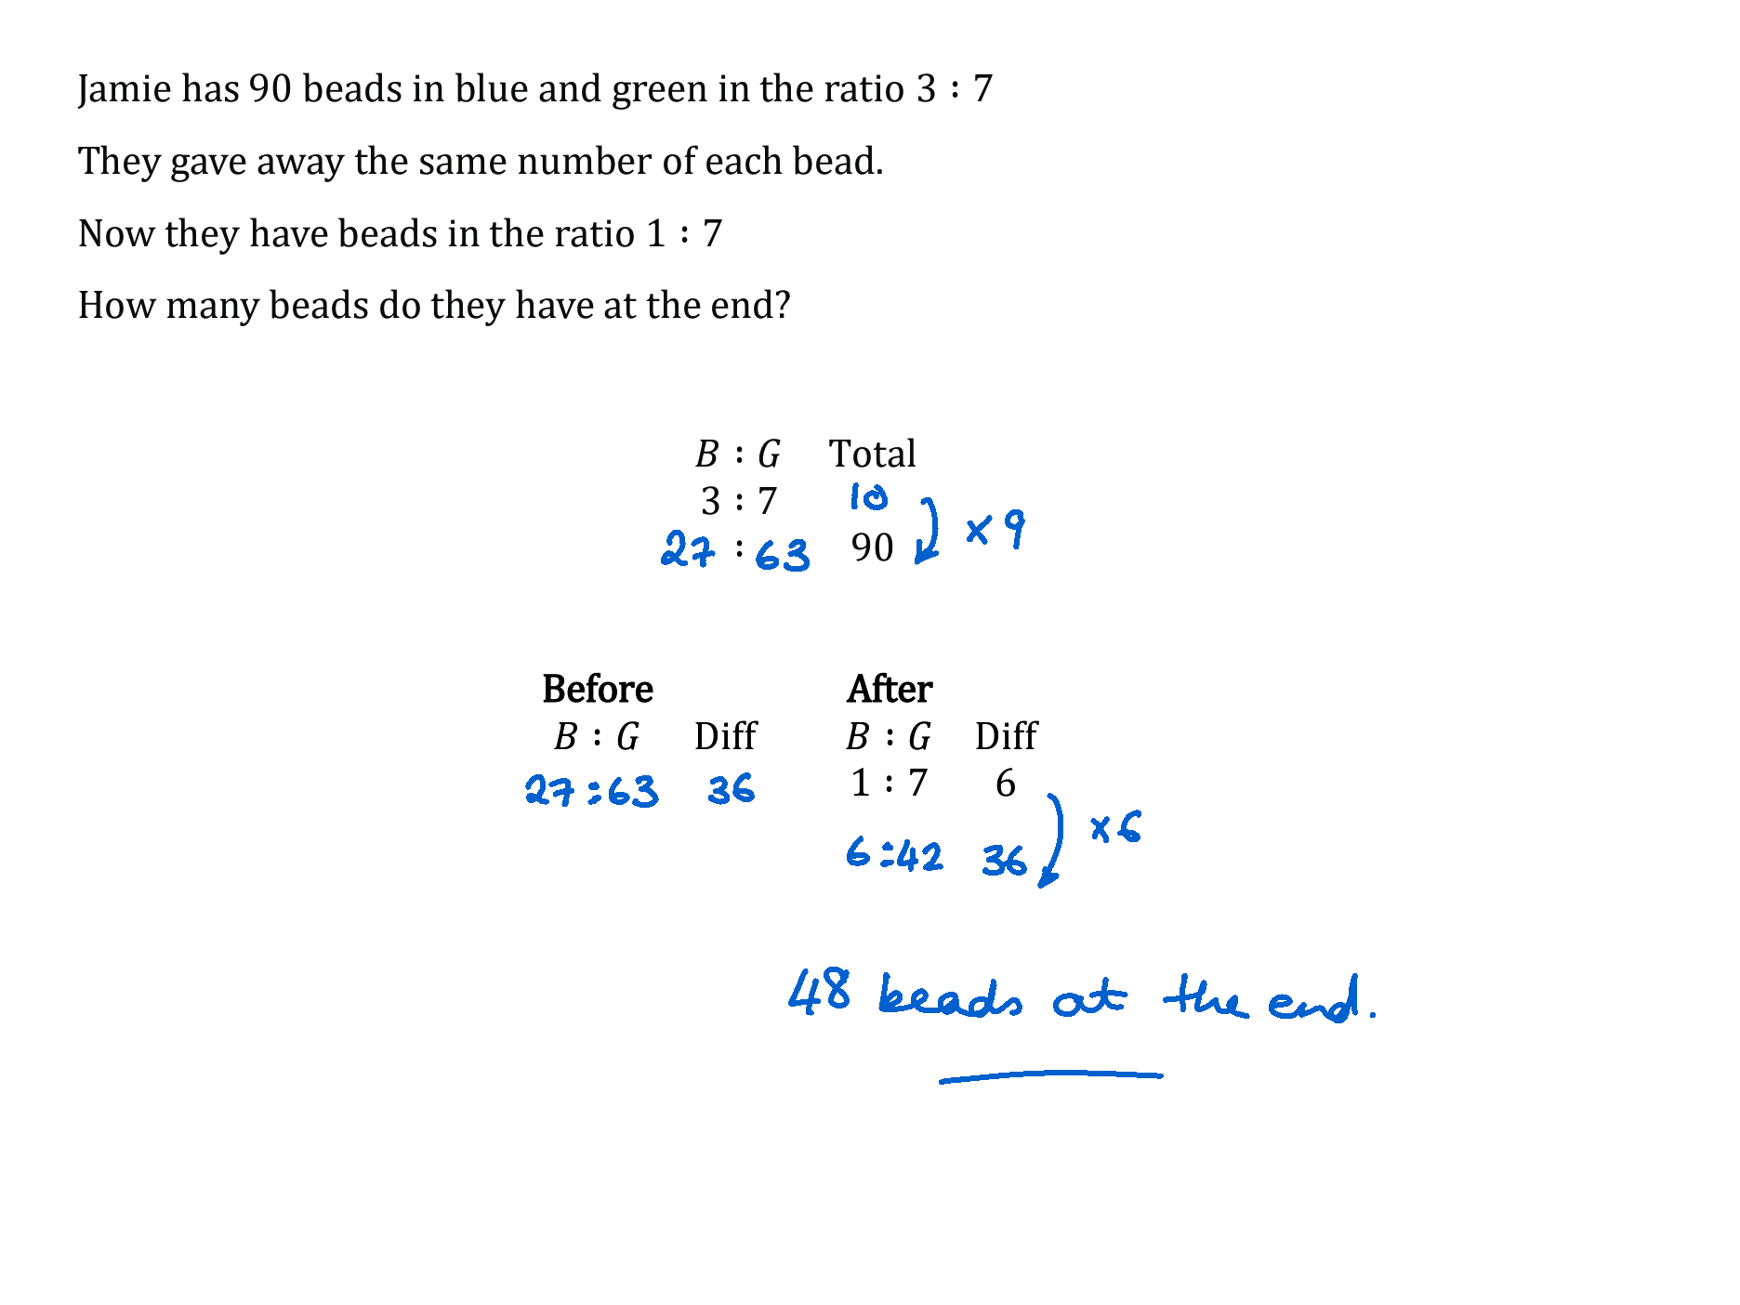
Jamie has 90 beads in blue and green in the ratio $3 :7$
They gave away the same number of each bead.
Now they have beads in the ratio $1 :7$
How many beads do they have at the end?
$$\begin{matrix}B :G & \text{Total} \\ 3 :7 & \\ : & 90\end{matrix}$$
$$\begin{matrix}\text{B}\text{efore} & & & \text{After} & \\ B :G & \text{Diff} & & B :G & \text{Diff} \\ & & & 1 :7 & 6 \\ & & & & \end{matrix}$$

Slide 11
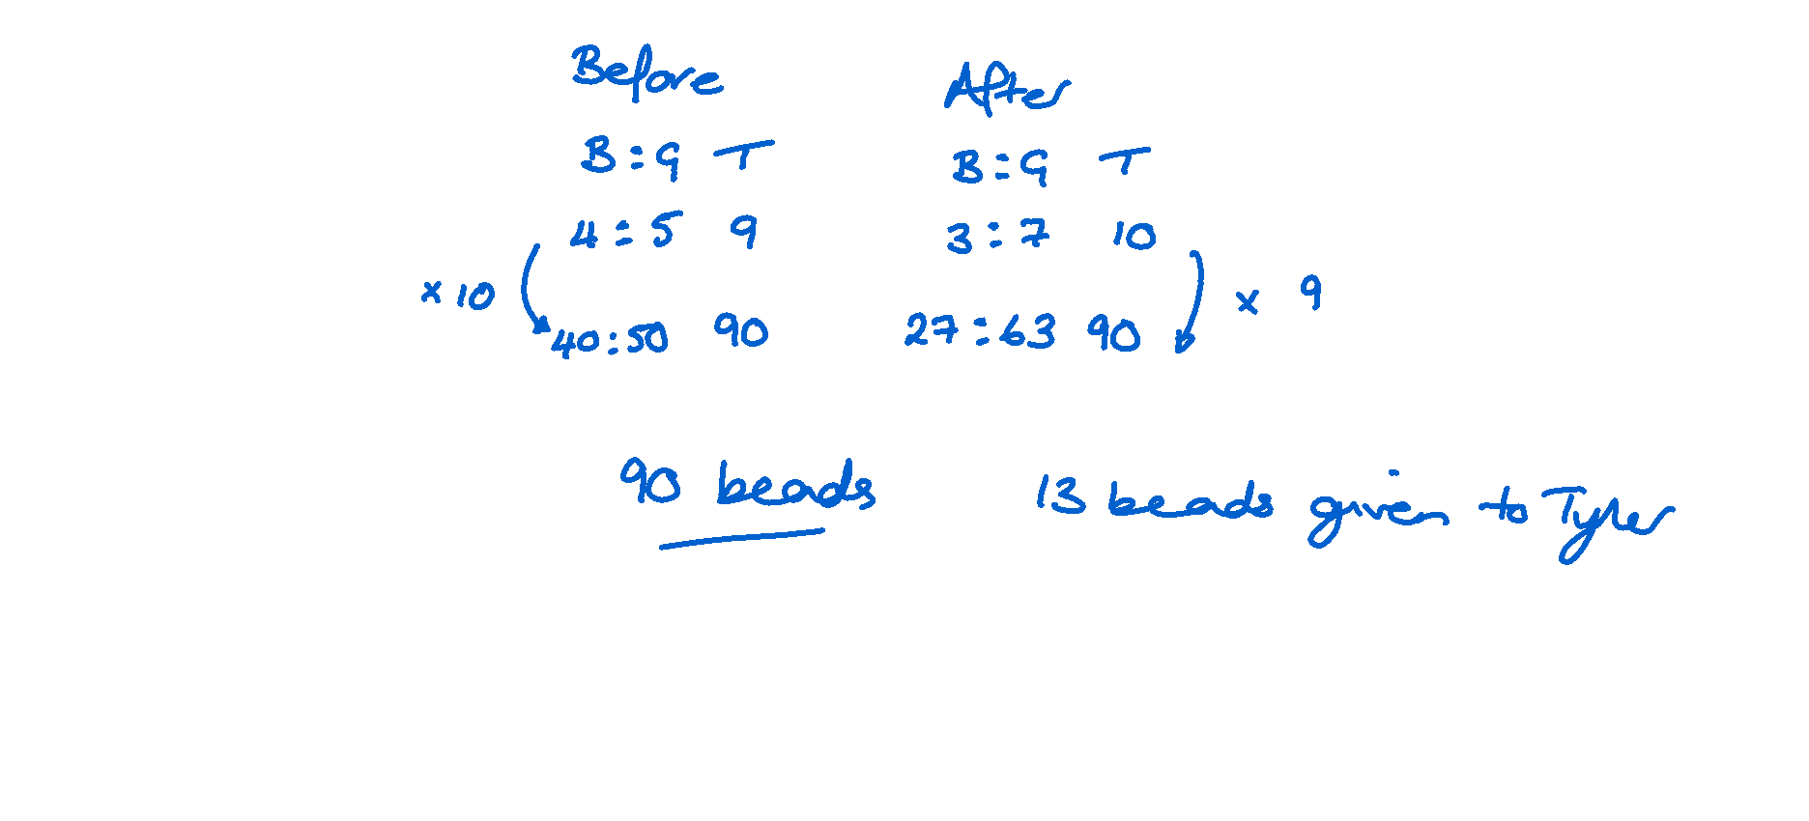
Jamie and Tyler have beads in a ratio of $4 :5$
Jamie gives some of their beads to Tyler.
The ratio is now $3 :7$
Find the smallest number of beads they could have started with and how many beads Jamie gives to Tyler.

Slide 12
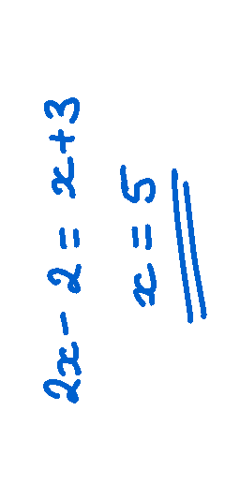
The following ratios are equivalent
$x−1 :x+1$ and $x+3 :x+7$
Find $x$
$$\begin{matrix} & \text{Diff} \\ x−1 :x+1 & 2 \\ & \\ x+3 :x+7 & 4\end{matrix}$$
$$2\left(x−1\right)=x+3$$
$$×2$$

Slide 13
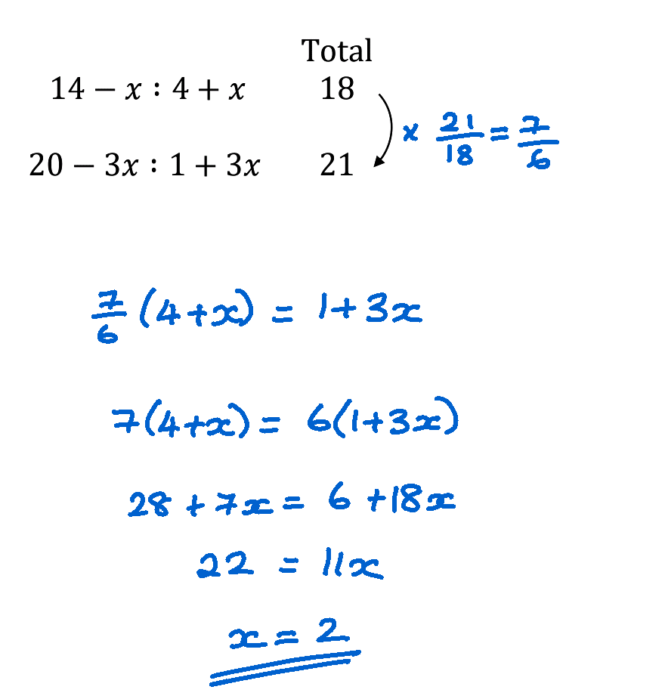
The following ratios are equivalent
$14−x :4+x$ and $20−3x :1+3x$
Find $x$
$$\begin{matrix} & \text{Total} \\ 14−x :4+x & 18 \\ & \\ 20−3x :1+3x & 21\end{matrix}$$

Slide 14
The following ratios are equivalent
$14+x :19+x$ and $24+3x :30+3x$
Find $x$

